Slide 1
CHAT FUNCTION Sharing File and Photo

Slide 2
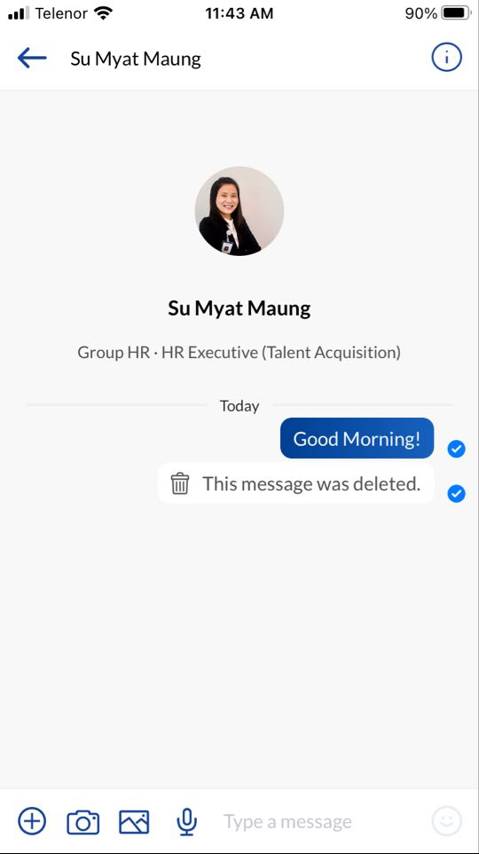
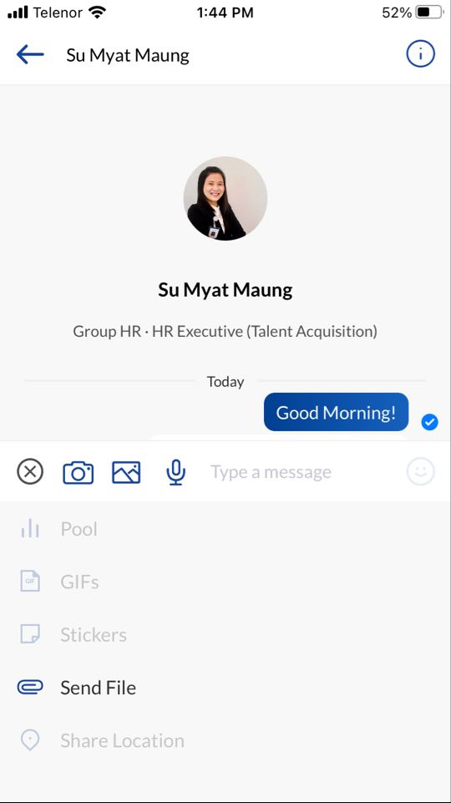
Sending File Yoma Connect App
Click on the
Click “Send File” and choose the file you wish to send.
Click to send the file.

Slide 3
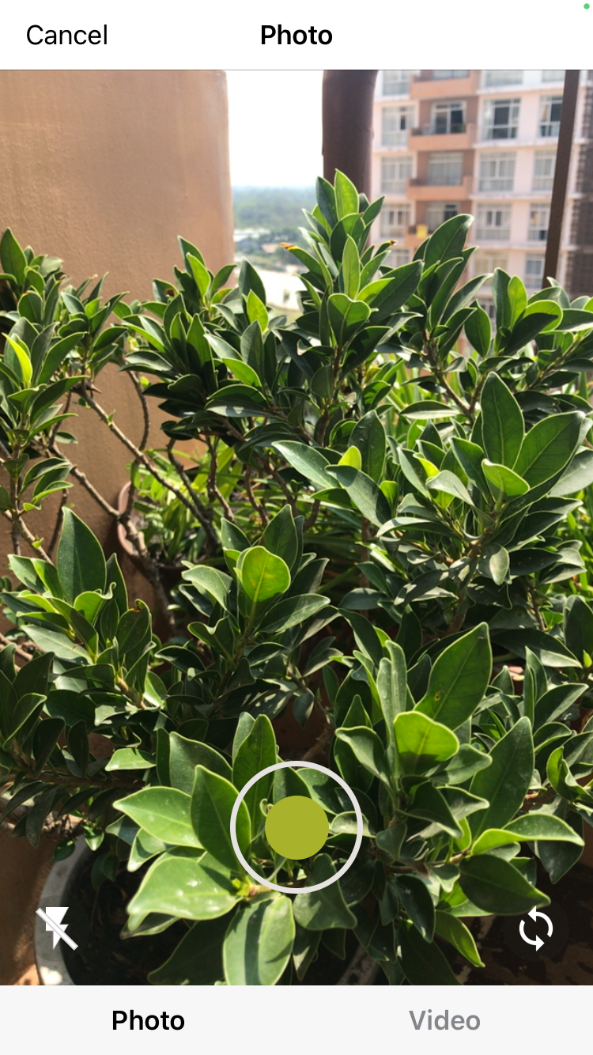
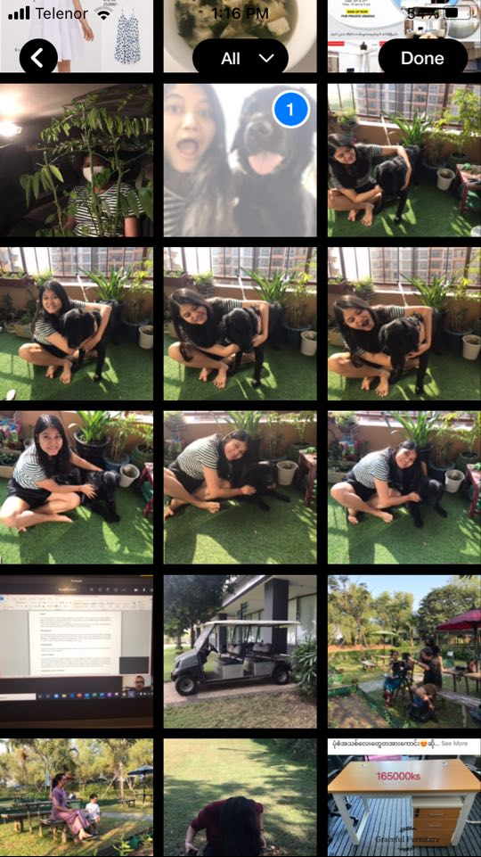
Sending Photo on Yoma Connect App
Sending a new photo
Click on the
A camera will open. Click on to take a new photo.
Click to send the taken photo.
Sending photo from Gallery
Click on the
Photo gallery will appear. Select the photo you wish to send.
Click to send the photo.

Slide 4
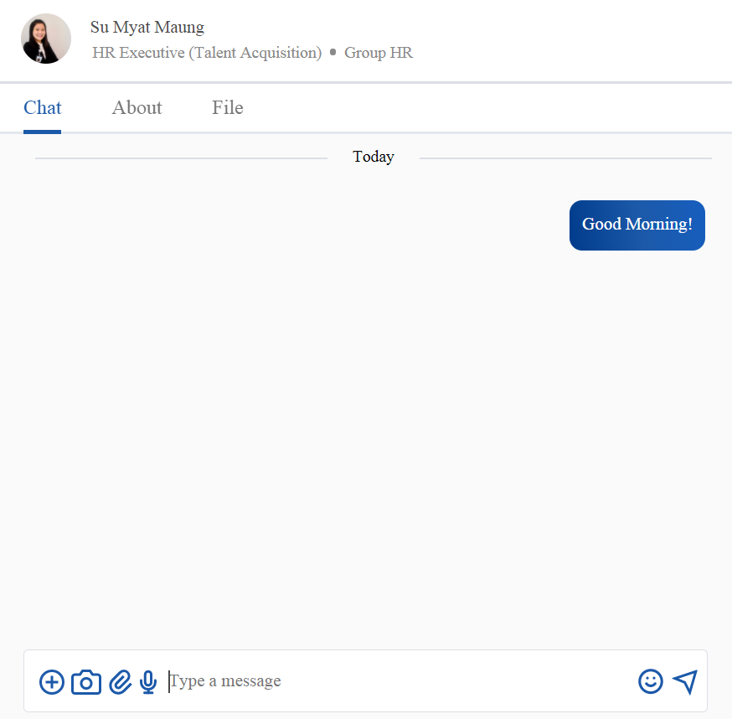
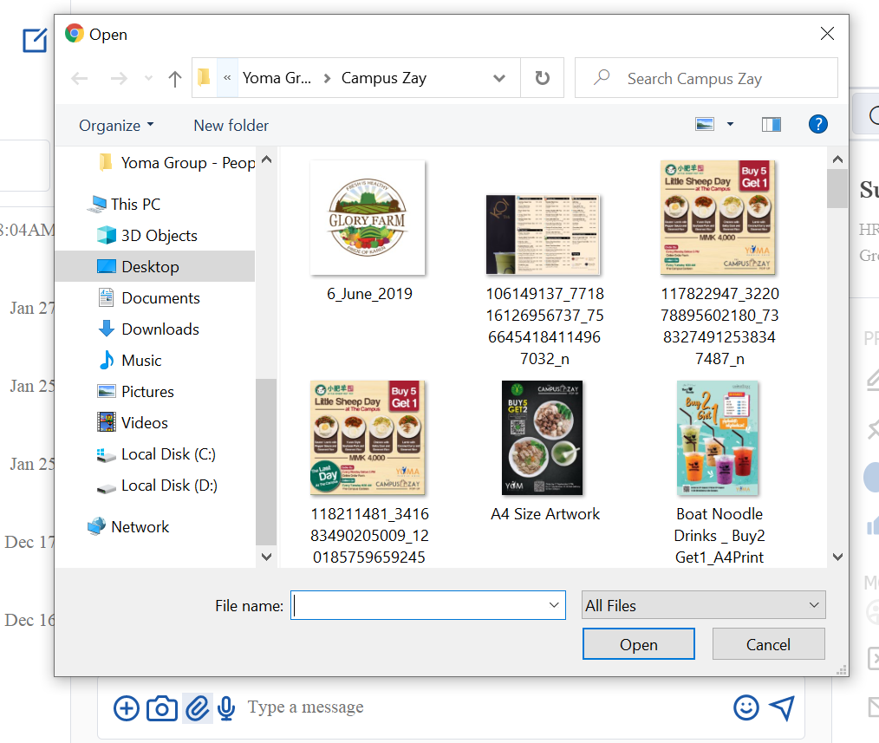
Sending File Yoma Connect Web Version
Click on the
New pop-up window will come up. Select the file.
Click to send the file.
Note
The existing photo from computer may share as file.

Slide 5
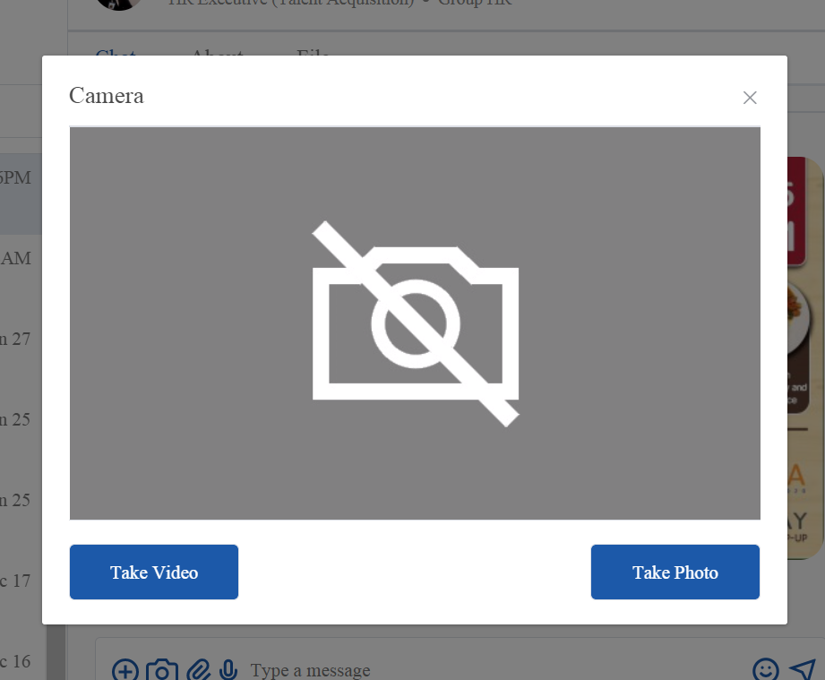
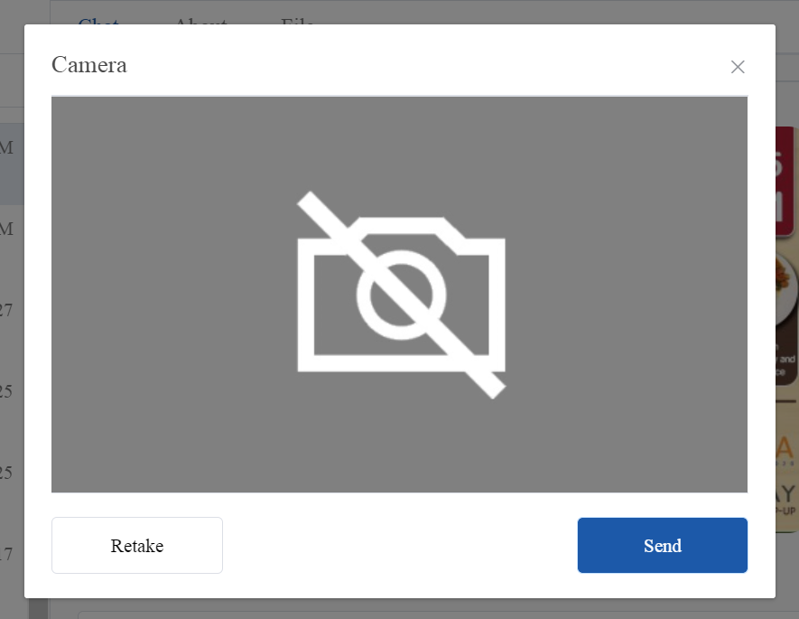
Sending Photo on Yoma Connect Web Version
Click on the
New camera window will pop-up. This function works on the computer with camera.
Click “Take Photo” to take new photo.
Click send.

